Slide 1
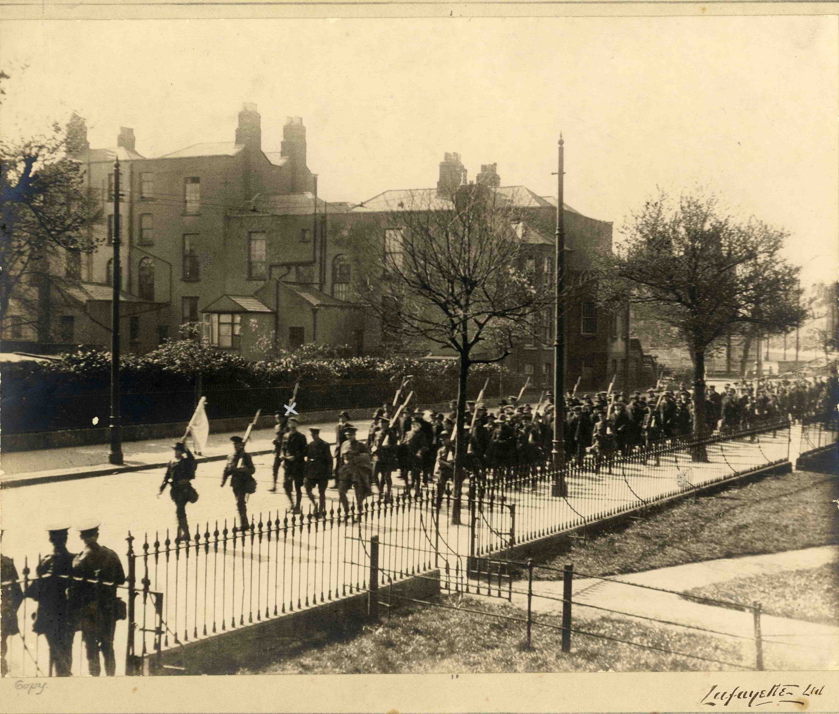
From the Edge: County Donegal in 1916
A short history of Donegal in the year of the Easter Rising/middle of World War I

Slide 2
Why County Donegal in 1916?
Decade of Centenaries 1912 – 1923: Commemorations began about 3 or 4 years ago. Period: Home Rule Bill, World War I, advent of Ulster Volunteers and National/ Irish Volunteers; 1916 Rising, 1918 General Election, War of Independence, partition, Civil War; foundation of Free State and Northern Ireland state.
Donegal County Archives has already produced a study pack covering the above period. In time for 1916 Rising centenary we are producing a 1916 heritage and education pack called: From the Edge: County Donegal in 1916.

Slide 3
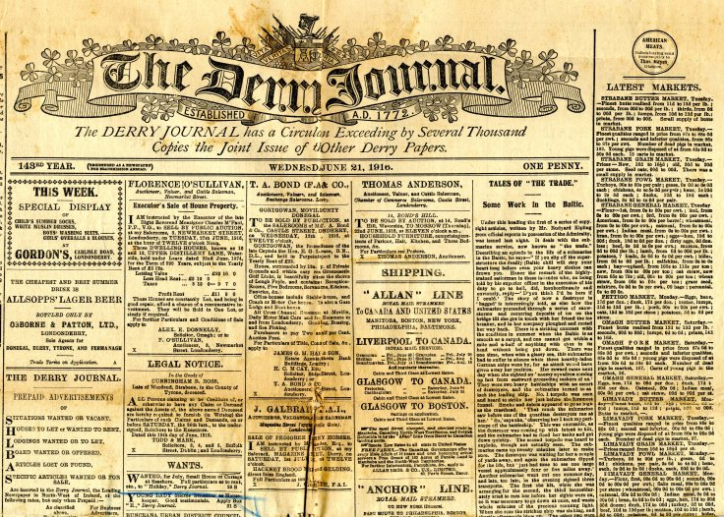
County Donegal in 1916

Slide 4
County Donegal in 1916- political situation
Politically only home rule candidates had been elected as Members of Parliament (MPs) in County Donegal since 1885.
In the 1911 local elections, 26 of the 32 seats had been won by home rule candidates.
Unionists resisted the Third Home Rule Bill. This opposition led to the formation of the Ulster Volunteers which in turn resulted in the formation of the Nationalist Volunteers in 1913.

Slide 5
County Donegal in 1916- political situation
The nationalist Irish Volunteer movement grew in Donegal and elsewhere in 1913 - 1914.
The Home Rule Act was suspended with outbreak of War in August 1914. With nationalist opinion divided over the war, the Volunteer movement split.
Following the split and an intensified recruitment campaign by the British Army, the nationalist Volunteer movement declined in 1915.
Membership of the nationalist (Irish) Volunteers would increase again only after the Easter Rising in 1916.

Slide 6
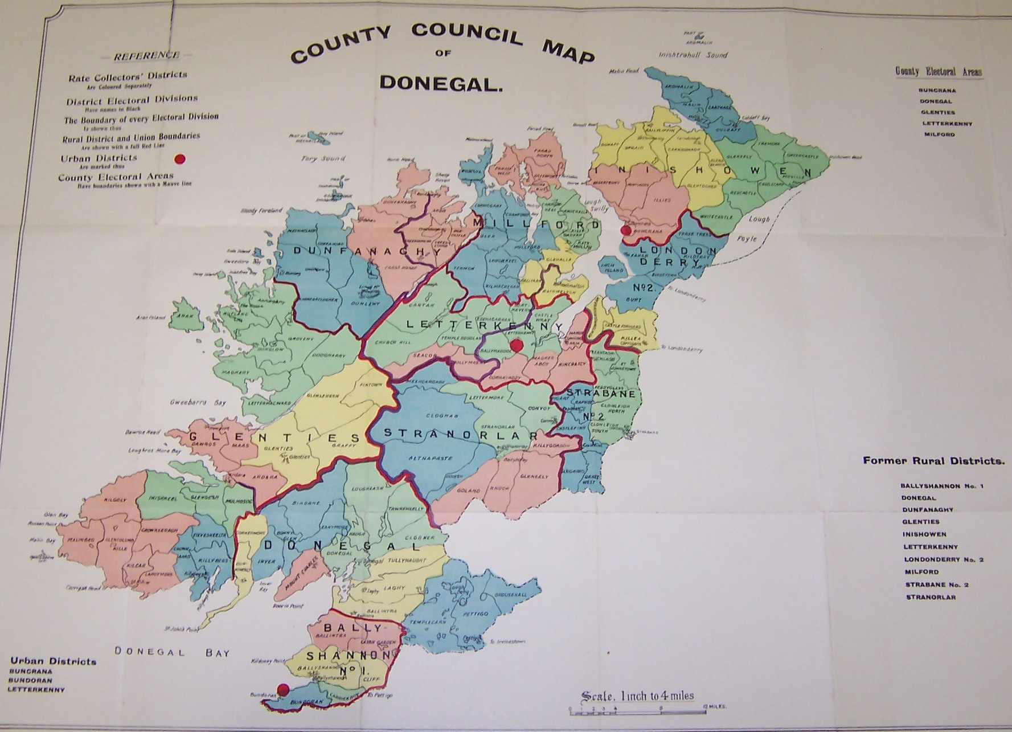
County Donegal in 1916 – on the land

Slide 7
Life in County Donegal– on the land
In 1916 County Donegal was a rural, farming community. Population: approximately168,000.
There were improvements in living conditions due to local authorities providing better housing, sewerage, water supplies; Congested Districts Board schemes included pier and harbour building, financially assisting local enterprises, fishing & agricultural development, railway development.
But housing was basic; no electricity or running water; there was an open fire in main room. 50% living in houses of two rooms. Four classes of houses.

Slide 8
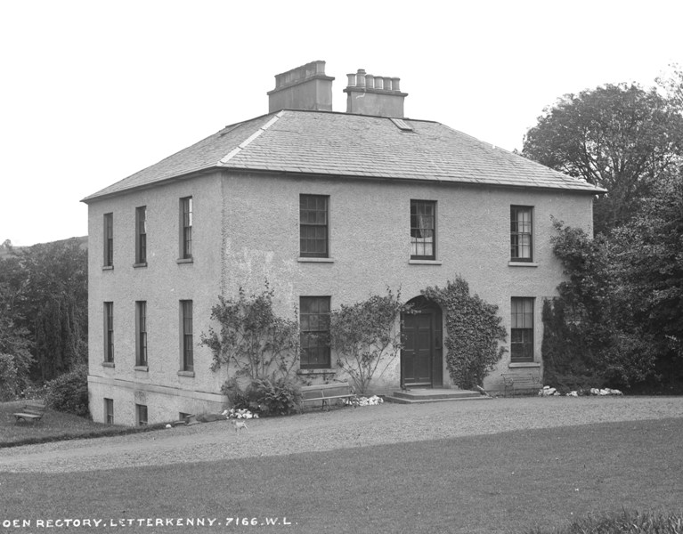
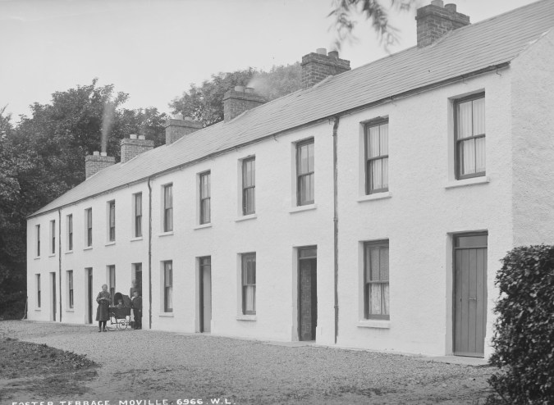
Life in County Donegal-on the land
Glendooen Rectory, First Class house
Foster Tce, Moville, Second Class house

Slide 9
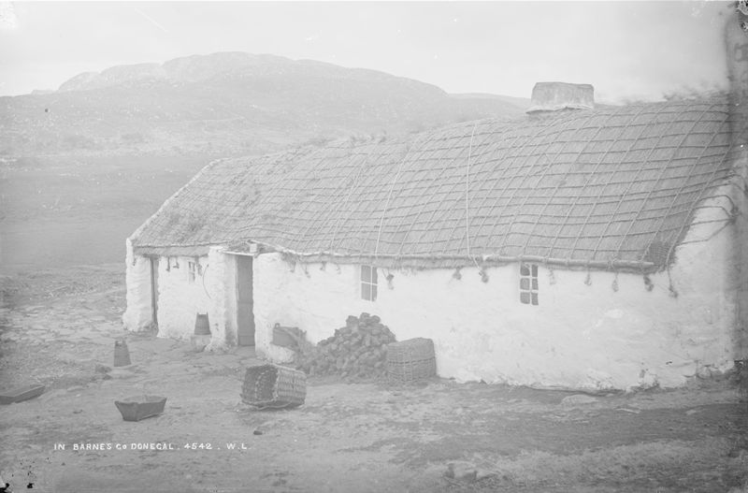
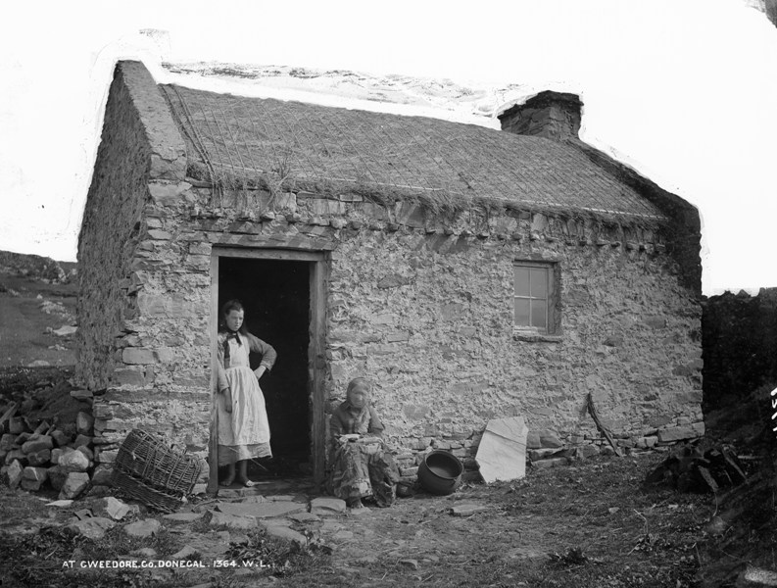
Life in County Donegal-on the land
Barnes, Third Class house
Gweedore, Fourth Class house

Slide 10
Life in County Donegal-on the land
Growth of co-operatives and creameries i.e. Templecrone (the Cope) in Dungloe was 10 years old in 1916.
Overall in Co Donegal, poor remote farming communities were the majority. Small subsistence farms in the west of the county, larger farms in the east.
However, by 1916, rural and town accommodation were improving, with ‘labourers’ and ‘housing of the working classes’ cottage schemes; though inspectors’ reports on the living conditions of labourers revealed the extent of grinding poverty still in existence. Little building by 1916 due to war.

Slide 11
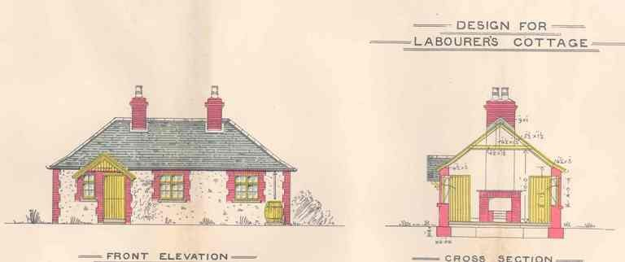
Life in County Donegal –on the land

Slide 12
Life in County Donegal –on the land
Much land was still owned by large landowning families in 1916, transference of land to small farmers under Land Acts had been interrupted by World War I (due to cost, lack of labour etc).
Seasonal migration by workers from west Donegal to farms in the Laggan was in decline by 1916 but another important seasonal migrant route to Scotland had been established.
Thousands of men had joined the British forces fighting World War I.

Slide 13
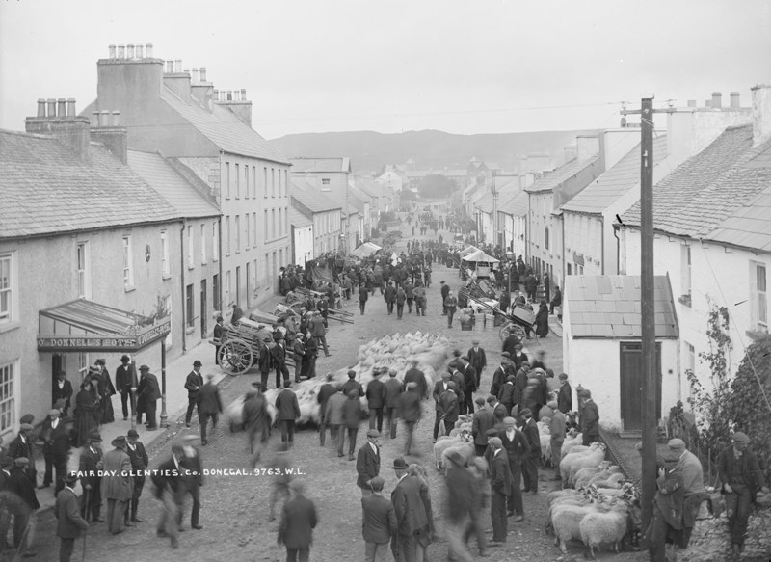
Life in County Donegal- on the land
Entertainment usually in the home, involved family, friends and neighbours exchanging stories and songs, sharing news, playing music together in the home; fair days.

Slide 14
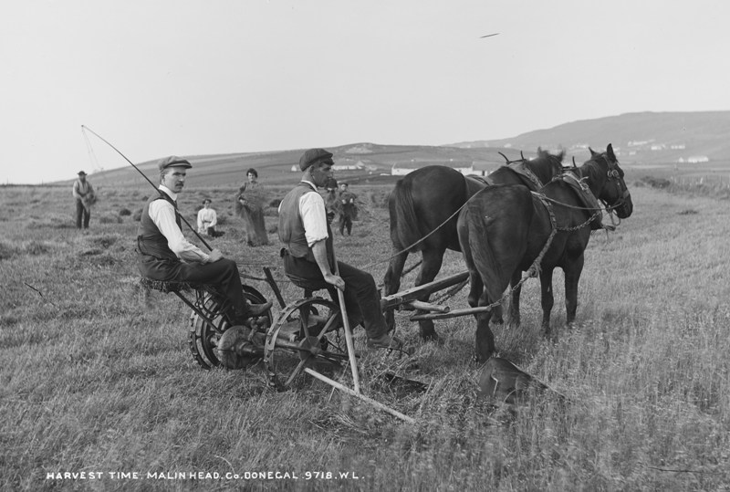
Life in County Donegal– Farming

Slide 15
Life in County Donegal- Farming
In early 20th century, the long tradition of arable farming had declined throughout Ireland including Donegal, and livestock farming, particularly of sheep, was on the rise.
Tillage was encouraged during World War I.
During the summer of 1916, there were fierce storms across county, low temperatures and heavy rain.
The combination of this, the labour shortage and the wet ground, caused many of the potatoes to rot.
The result was increased prices and a shortage of potatoes. This also affected the seed crop for sowing the following year.
Main beneficiaries of rising prices were the wealthier farmers.

Slide 16
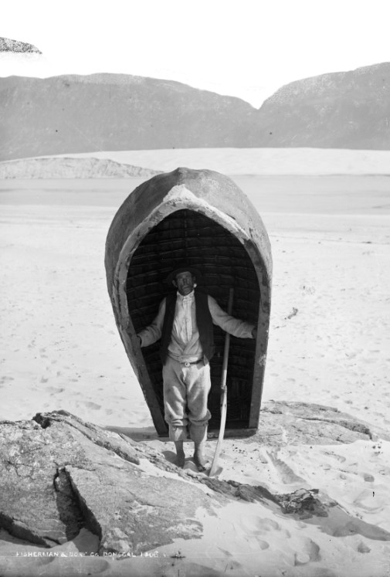
Life in County Donegal- Fishing
Fishing under threat even before War due to large steam drifters operating from Scotland;
Instead Donegal fishermen used smaller Greencastle yawls. Neighbours often shared boats.
Fishermen had to sell produce in smaller quantities, and to support the larger industry with jobs such as packing, gutting, curing and carting.

Slide 17
Life in County Donegal- Fishing
With the onset of war, the steam drifters were requisitioned by the Admiralty.
Fishing was banned along the west Donegal coast and mines were laid in the waters around Donegal.
The Congested Districts Board had planned to invest in the fishing industry in Co Donegal- war curtailed this.
People involved in fishing including the ancillary industries were left jobless.

Slide 18
Life in County Donegal -Fishing
Local men continued to fish inshore, away from the mines, and gradually local businessmen filled the void left by the Scottish steam drifters.
Herring was plentiful in 1916/1917 and prices rose. Railways helped transport of fish to market.
Unstable employment opportunities in fishing and farming usually led to migration but this had virtually stopped by 1916 as conscription and resulting recruitment to the British Army intensified in Scotland.

Slide 19
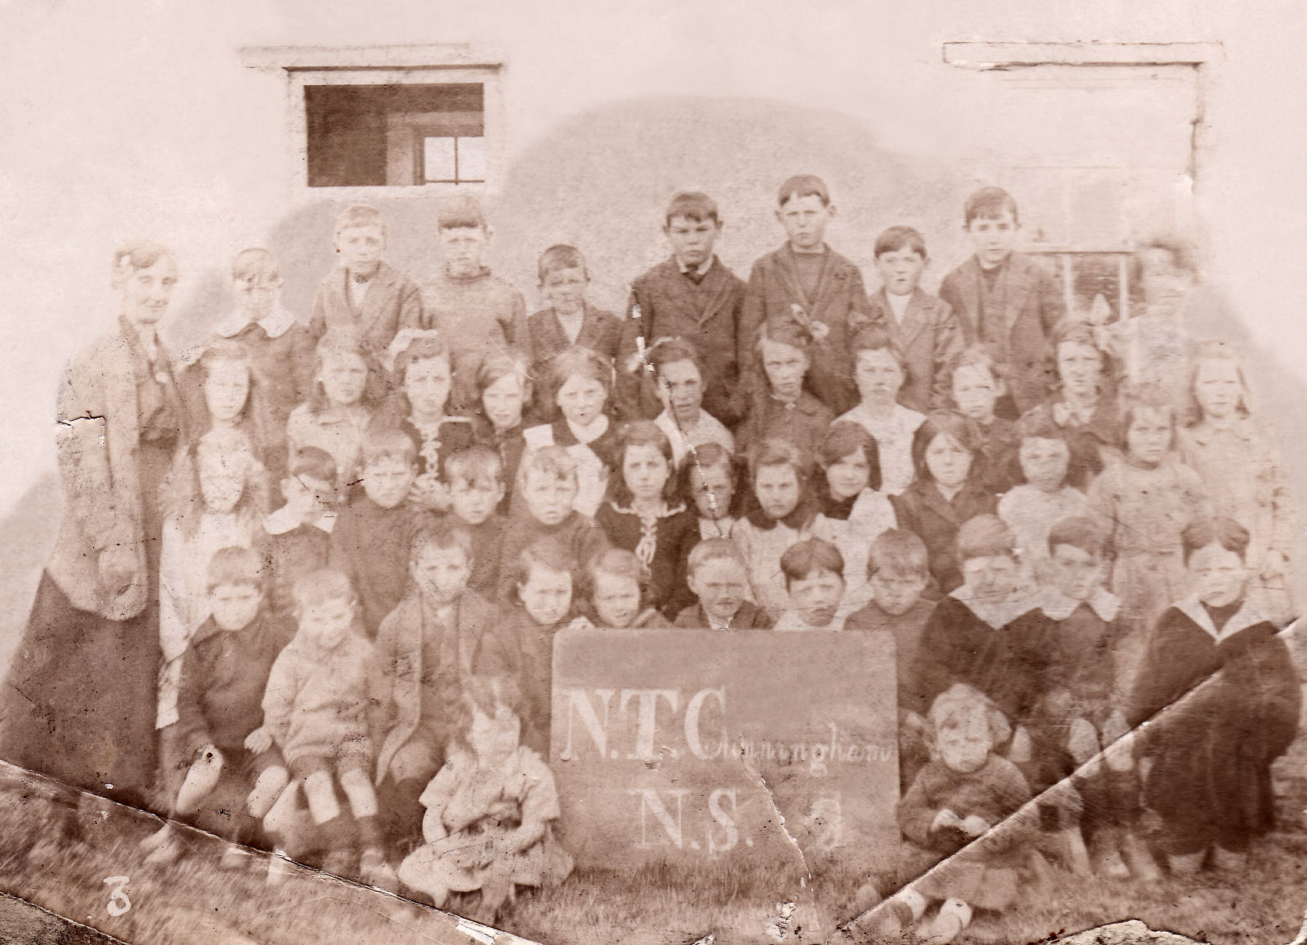
Life in County Donegal- children

Slide 20
Life in County Donegal- Children
Unemployment led to increase in children being hired out to the more fertile farms of the Laggan in east Donegal.
Some teenagers even sent to Scotland as ‘tattie hokers’ from 1915 to 1918.
Education Commissioners stated that 70 percent of children attended school regularly in 1916.
Teachers in Donegal despaired that children would ever receive a decent education.

Slide 21
Life in County Donegal- Children
In 1916 rural schoolhouses in County Donegal usually had one room.
Children often had to collect firewood and turf from the locality to keep their building warm in winter.
Children were frequently absent from school to help at home & on farm, particularly during harvesting.
Children often attended school in bare feet and inadequate clothing; absences due to illness were also frequent.

Slide 22
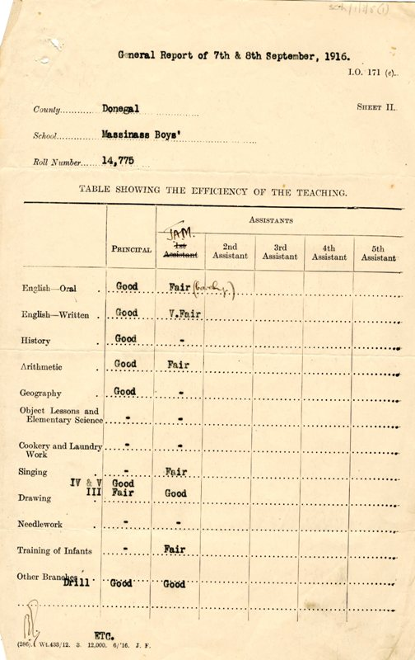
Life in County Donegal- Children
From the timetable you see here, a surprising variety of subjects taught.
Drawing, singing as well as maths, reading, writing, history and geography.

Slide 23
Life in County Donegal - Children
Extra subjects for girls: laundry, cooking, needlework.
Timetable doesn’t include religion but presumably clergy came to teach doctrinal subjects.
Irish was not taught in Donegal schools in 1916 except in some schools as an ‘extra subject.’

Slide 24
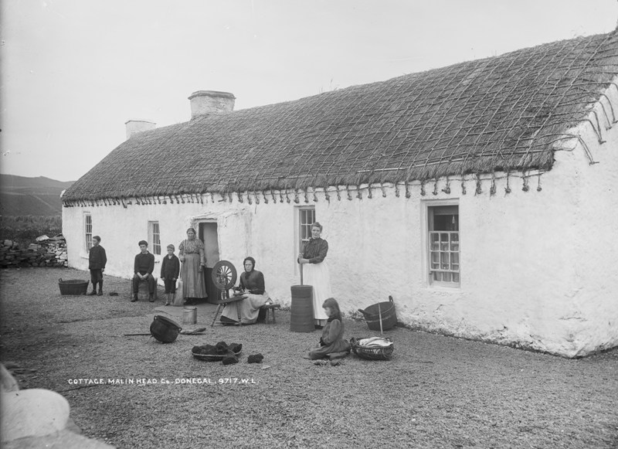
Life in County Donegal- Women

Slide 25
Life in County Donegal- Women
Women worked at home, and also outside on farms, sold produce; particularly during the War.
Cottage industries included knitters, weavers, embroiderers and lace makers.
Some younger women migrated as tattie hokers to Scotland.
Many worked in fishing industry, ‘gutters’, packers etc.
They also worked as teachers, domestic servants, shop assistants, typists.
Mortons carpet factory at Killybegs.

Slide 26
Life in County Donegal- Women
During World War I, women knitted supplies for war.
In rural Donegal women gathered sphagnum moss for surgical dressings which were in huge demand.
Served as nurses at the Front: e.g. Catherine Black from Ramelton: “at night, the cheerful ward became a place of torment, with the occupants of every bed tossing and turning and moaning in the hell of memories let loose”.

Slide 27
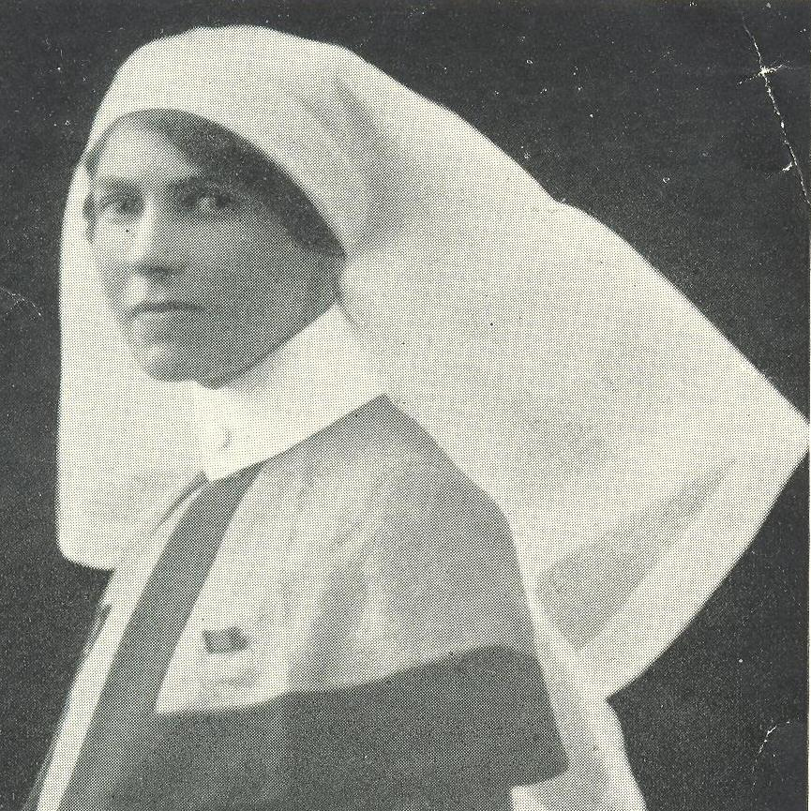
Life in County Donegal- Women
Catherine Black from Ramelton, Co Donegal

Slide 28
Life in County Donegal- Women
Irish Women’s Franchise League was established in 1908 to campaign for the right to vote. By 1916, although female property owners could vote and stand for all local elections, women could not vote or stand in general elections.
Women involved in Cumann na mBan included Eithne Coyle- (War of Independence).
Women were involved in Gaelic cultural revival, Gaelic League.

Slide 29
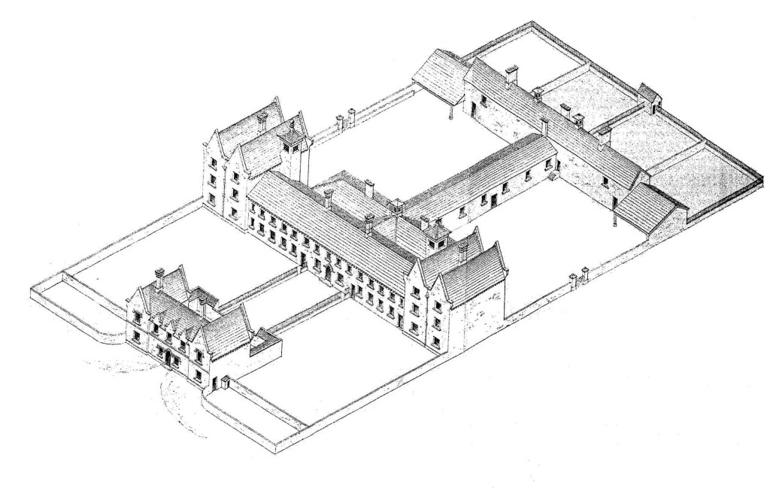
County Donegal: Poverty & Health

Slide 30
Poverty & Health- Workhouses
Eight workhouses: Ballyshannon, Donegal, Carndonagh, Dunfanaghy, Glenties, Stranorlar, Letterkenny, Milford.
People, young and old, homeless, destitute or ill and incapable, were still frequently forced into workhouses.
Diseases that are now mainly gone still existed in 1916: e.g.: measles, diphtheria, typhoid, typhus fever, scarlatina, enteric fever, whooping cough, tuberculosis and virulent strains of influenza. Fever hospitals at local workhouses attended to sick.
Orphaned children were ‘boarded out’ from workhouse.

Slide 31
Poverty & Health- Workhouse hospitals
The average cost of an inmate for a week in Dunfanaghy workhouse in1916 was five shillings and 8 and a half pence, for taking care of the patients in the infirmary it was six shillings and five pence.
Ballyshannon Fever Hospital tended to sick and injured soldiers whose base was the nearby Finner Camp.
In 1916 the hospital tended to 37 soldiers of the twelfth battalion of the Royal Inniskilling Fusiliers.

Slide 32
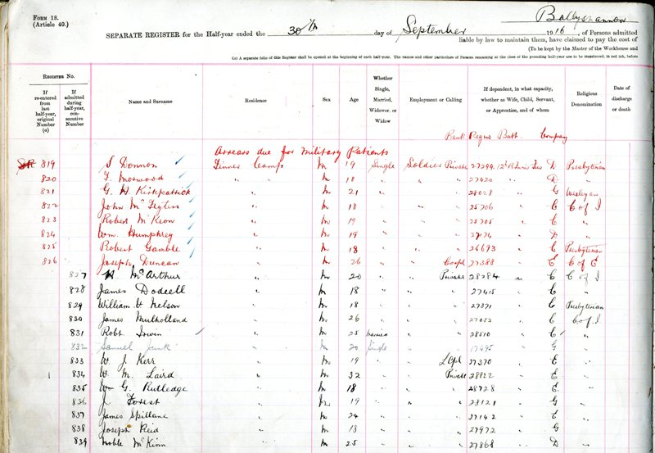
Poverty & Health- Workhouse hospitals
Ballyshannon Fever Hospital 1916 with Army personnel patients.

Slide 33
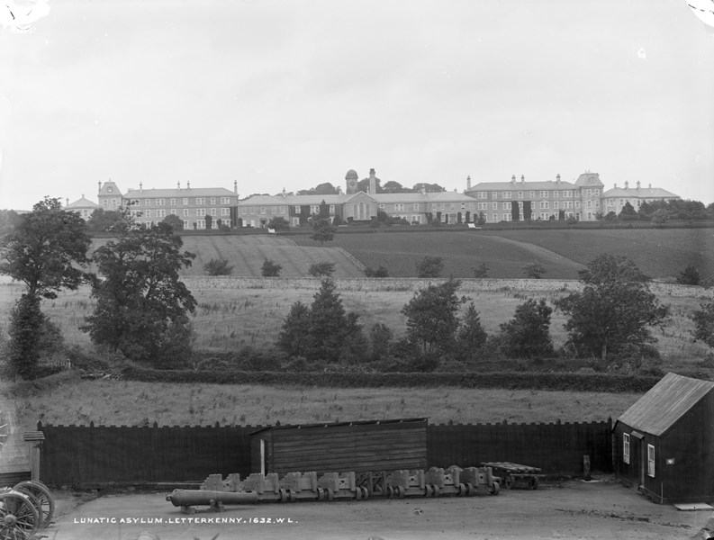
Poverty & Health- Mental health
In 1916, 134 people were admitted to Donegal District Lunatic Asylum (St Conal’s). Of those, 86 were men and 48 women. The youngest in 1916 was a 13 year old boy and the oldest was a 77 year old man.

Slide 34
Poverty & Health – Mental health
St Conal’s 1916 patients:
Included were shop assistants, labourers, farmers, housekeepers, clerks, domestic servants, dealers and shoemakers, a policeman, a church verger, a solicitor, a hawker, a flax scutcher, a soldier, a sailor and an ex-soldier, a ‘lady of means’.
Only one man admitted in 1916 was a serving soldier, aged 21, sent there by the British Army from Dykebar War Hospital in Paisley. A casualty of war, he was stated to be suffering from depression due to ‘stress of campaign.’ He was discharged in 1917.

Slide 35
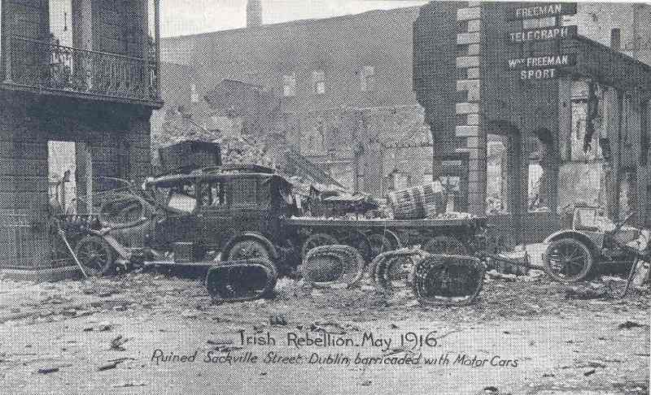
The Easter Rising 1916

Slide 36
The Easter Rising 1916
Began Easter Monday 24 April. The rebels occupied key buildings: the GPO, the Four Courts, the South Dublin Union, Boland’s Mill, Stephen’s Green and Jacob’s Biscuit Factory, but crucially Dublin Castle was not held.
On Tuesday, martial law was declared, and 16,000 British troops arrived from Belfast, the Curragh and from England. Tanks and a naval gunboat, the Helga, were used in the city centre to suppress the rising.
485 men, women and children were killed during or as a direct result of the Easter Rising. Of these casualties, 184 civilians, 107 British soldiers, 58 rebels and 13 members of the police forces were killed between 24 and 29 April.

Slide 37
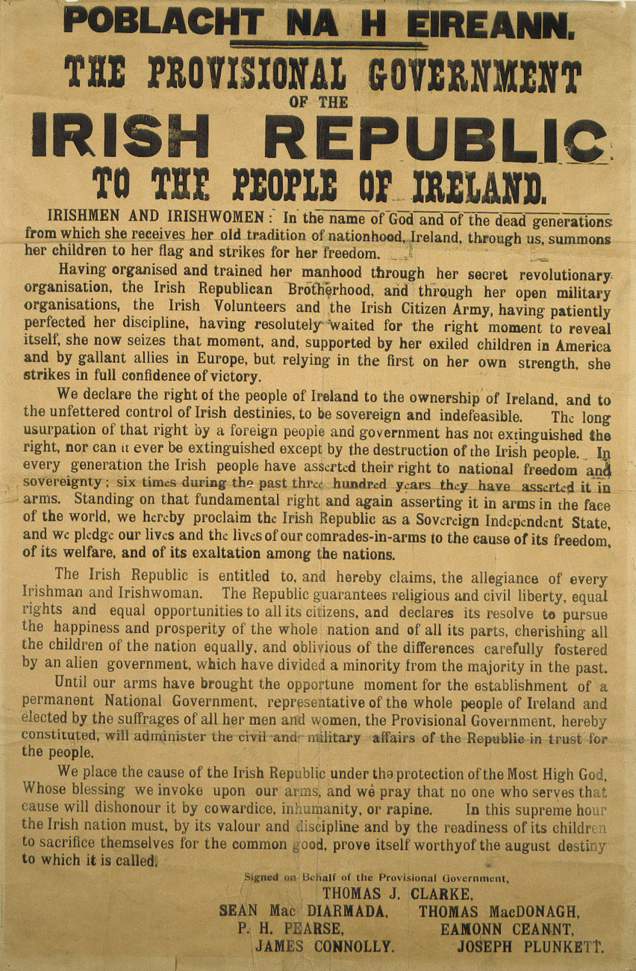
The 1916 Rising- what happened in Donegal
As we’ve seen the effect of World War I was visible everywhere in County Donegal. But the Rising?
Though it began on Easter Monday 24 April 1916, news of the events only reach Donegal on Friday.

Slide 38
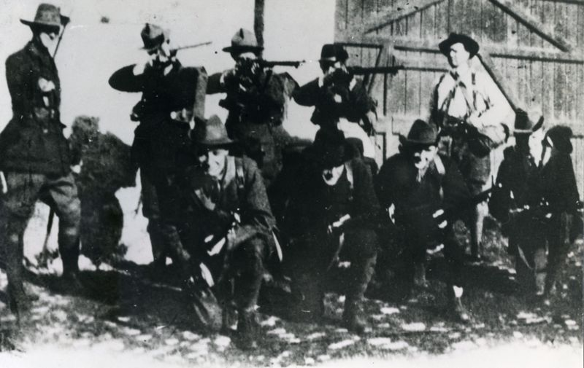
Donegal & The Rising: participants
Main player from Donegal: Joseph Sweeney, who later became youngest Dáil member, and Chief of Staff of Irish army.
Pupil of Patrick Pease at St Enda’s in 1916 (also UCD student); making munitions prior to Rising.
He fought in the GPO – ‘engaged for the most part in sniping’ and later wrote of his experiences. He was a stretcher bearer for James Connolly. Supported Treaty.

Slide 39
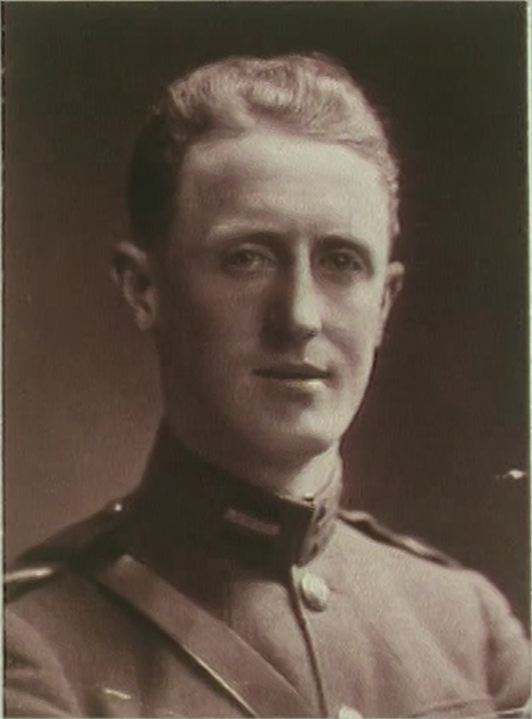
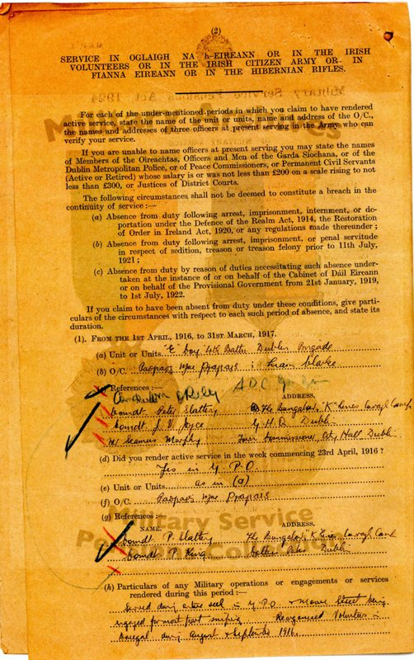
Donegal & The Rising: Joseph Sweeney

Slide 40
Donegal & The Rising: participants in Dublin
Joseph Sweeney, and two McGinley brothers Eunan and Conor spent time in British prisons after Rising.
When they came home they set about recruiting Irish Volunteers in preparation for the War of Independence.
Daniel Kelly based in Cashelnagore, Gortahork, had organised IRB and Volunteers.
Tried to get to Dublin to fight during Easter Week, no trains. Arrested and sent to gaol in Britain. Out later that year.

Slide 41
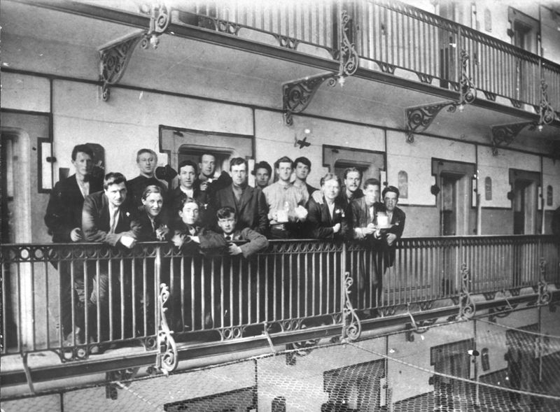
Donegal & The Rising: participants in Dublin
Irish prisoners in Stafford gaol including Joseph Sweeney, Eunan McGinley and Michael Collins.

Slide 42
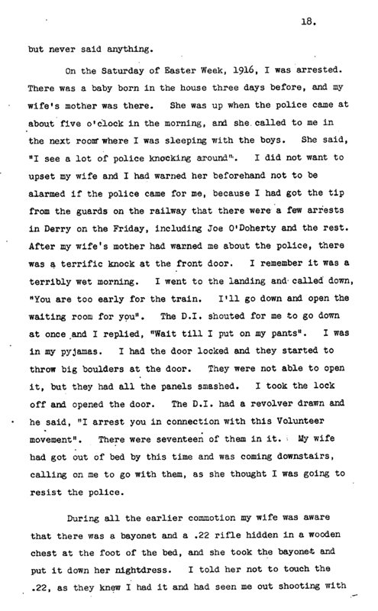
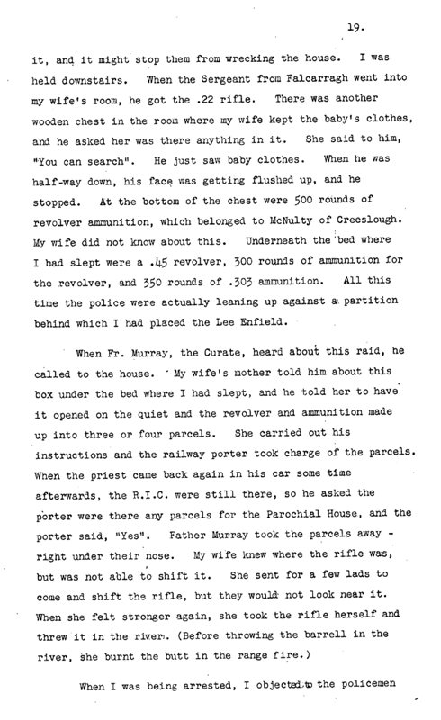
Donegal & The Rising: Daniel Kelly

Slide 43
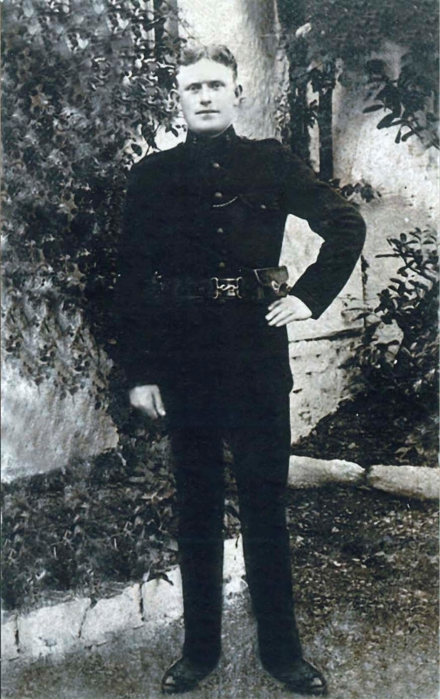
Donegal & The Rising: Charles McGee
Charles McGee from Inishbofin, was a Constable in the Royal Irish Constabulary. He was based in Castlebellingham in County Louth.
On the morning of 24 April 1916, Volunteers from Dundalk Louth raided the RIC barracks in Castlebellingham and McGee was shot dead, an army officer wounded.

Slide 44
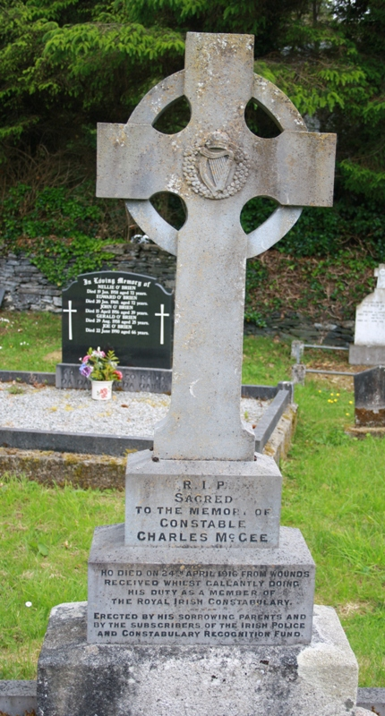
Donegal & The Rising: Charles McGee
Const McGee’s Headstone in Gortahork: R.I.P. Sacred to the memory of Constable Charles McGee who died on 24th April 1916 from wounds received whilst gallantly doing his duty as a member of the Royal Irish Constabulary — Erected by his sorrowing parents and by the subscribers of the Irish Police and Constabulary Recognition Fund.

Slide 45
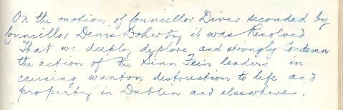
The 1916 Rising- Reaction in Donegal
Friday of Easter Week before information filtered through of the Dublin events.
Negative reaction in Donegal initially expressed by media & politicians.
On the motion of Cllr Diver seconded by Cllr Denis Doherty it was resolved that we deeply deplore and strongly condemn the action of the Sinn Fein leaders in causing wanton destruction to life and property in Dublin and elsewhere (Inishowen RDC).

Slide 46
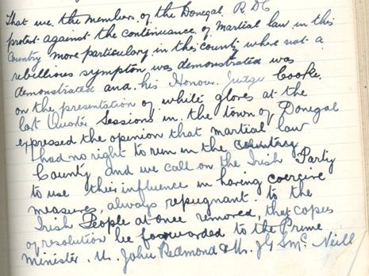
The 1916 Rising- Reaction in Donegal
As martial law was implemented and leaders were shot and imprisoned many changed their minds and support for independence grew.
Membership of Volunteers grew again and antipathy to World War I grew.
That we the members of the Donegal RDC protest against the continuance of martial law in this county….

Slide 47
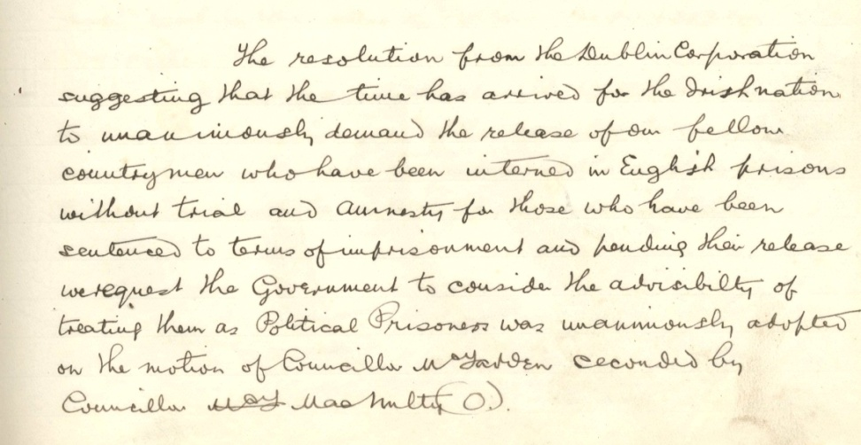
The 1916 Rising- Reaction in Donegal
The resolution…that the time has arrived for the Irish nation to unanimously demand the release of her fellow of her fellow countrymen who have been interned in English prisons…was unanimously approved…. (Dunfanaghy RDC)
Prisoners were gradually released and welcomed across Donegal and Ireland.
Many unionists in Donegal were not happy – feared for their future in a divided Ireland.

Slide 48
The 1916 Rising- Reaction in Donegal
In September 1916 the RIC County Inspector expressed concern about the growing number of young Donegal men who, unable to travel to Scotland and England to find work, were joining nationalist organisations:
These men and their families have become sullen and discontented…there is little doubt but that they will come together, discuss their grievances, form some societies, secret or otherwise. Extremists will hear of their discontent and will probably endeavour to utilise if for their own ends.”

Slide 49
The 1916 Rising: leaders & Donegal: Pearse
Patrick Pearse visited County Donegal a number of times between 1906 and 1914, to promote Irish language, on behalf of the Gaelic League; vistied Colaiste Uladh. Invited by Daniel Kelly in 1916 the Rising intervened.
Pearse’s only law case was when he represented Niall MacGiolla Bhride from Creeslough in McBride v McGovern in 1906. McBride was prosecuted because his trap displayed his name and address in the Irish language and in the Gaelic font.

Slide 50
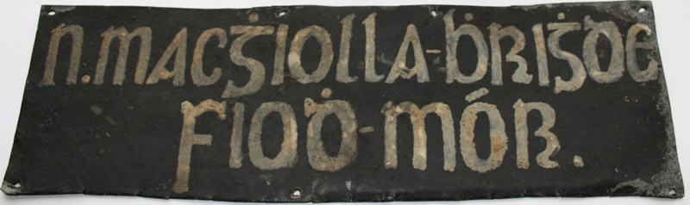
The 1916 Rising: leaders & Donegal: Pearse
MacGhiolla Bhride’s controversial trap sign

Slide 51
The 1916 Rising: leaders & Donegal: MacDonagh & Plunkett
Thomas MacDonagh, another of the 7 signatories of the Proclamation, visited Inishowen, on the invitation of the Irish Volunteers in April 1914, speaking at a rally in Carndonagh. He praised the Irish Volunteers as a national movement.
MacDonagh fought in GPO and was executed in May 1916.
Joseph Mary Plunkett, also a signatory, learned Irish in Colaiste Uladh. There he met a girl called Columba O’Carroll, the daughter of a family friend. He wrote love poems for her.

Slide 52
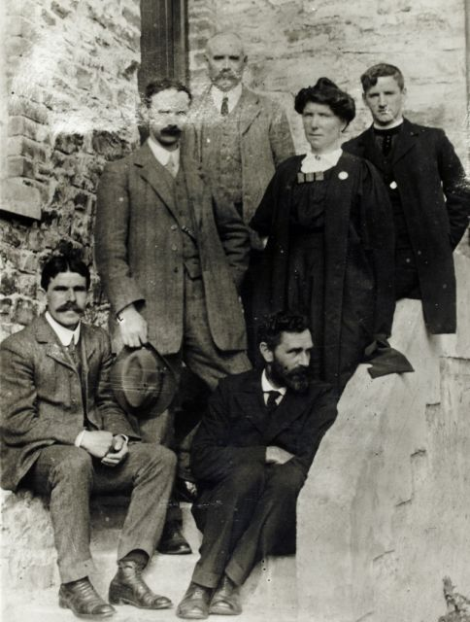
The 1916 Rising: leaders & Donegal: Casement
Roger Casement spent a lot of time in Co Donegal between 1904 and 1906, attended Colaiste Uladh, donating £100 towards the building of the new school; he visited Tory Island, Fanad, Portsalon.
Casement was arrested following the failed attempt to land arms in Kerry and was hanged at Pentonville Prison on 3 August 1916.

Slide 53
Further information
www.militaryarchives.ie
www.nli.ie
www.census.nationalarchives.ie/
www.donegalcoco.ie/culture
Sweeney, Frank, Letterkenny & Burtonport Extension Railway 1903 – 1947. Ph.D. thesis, NIU Maynooth, October 2004.
The Donegal Awakening by Liam O Duibhir
Donegal Annual Journal 1966
From the Edge: County Donegal in 1916 Heritage and Education pack (publication date Jan 2016)

