Slide 1
Revolutionary Ireland
Decade of Centenaries
1912-23
The events that happened from 1912-23 are still impacting Ireland today.
Think about: Brexit, Northern Ireland, the Border and the Troubles.

Slide 2
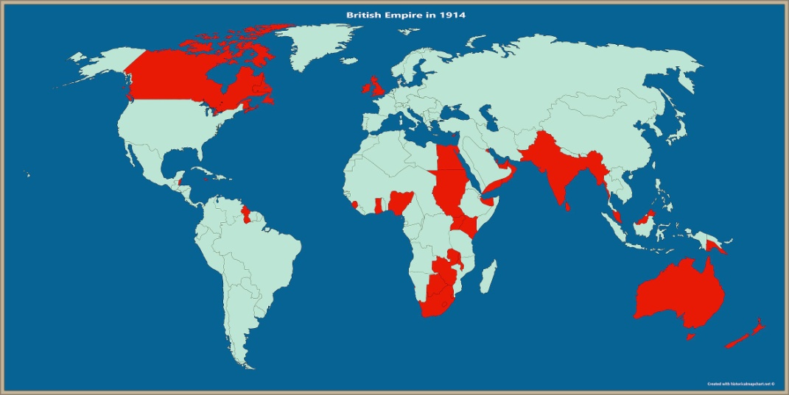
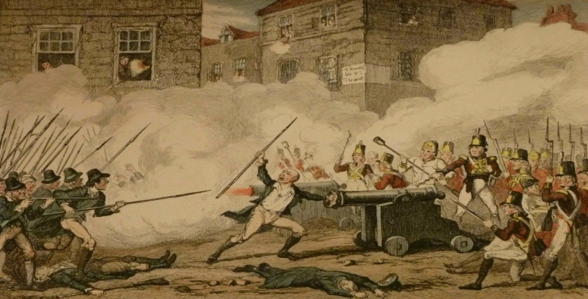
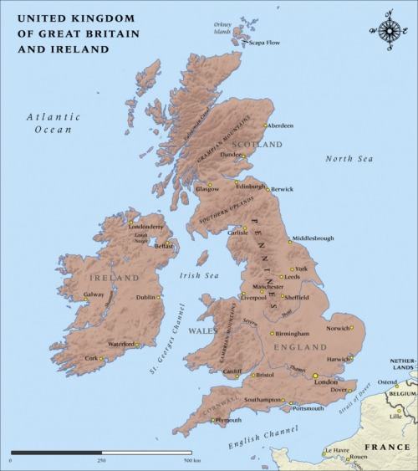
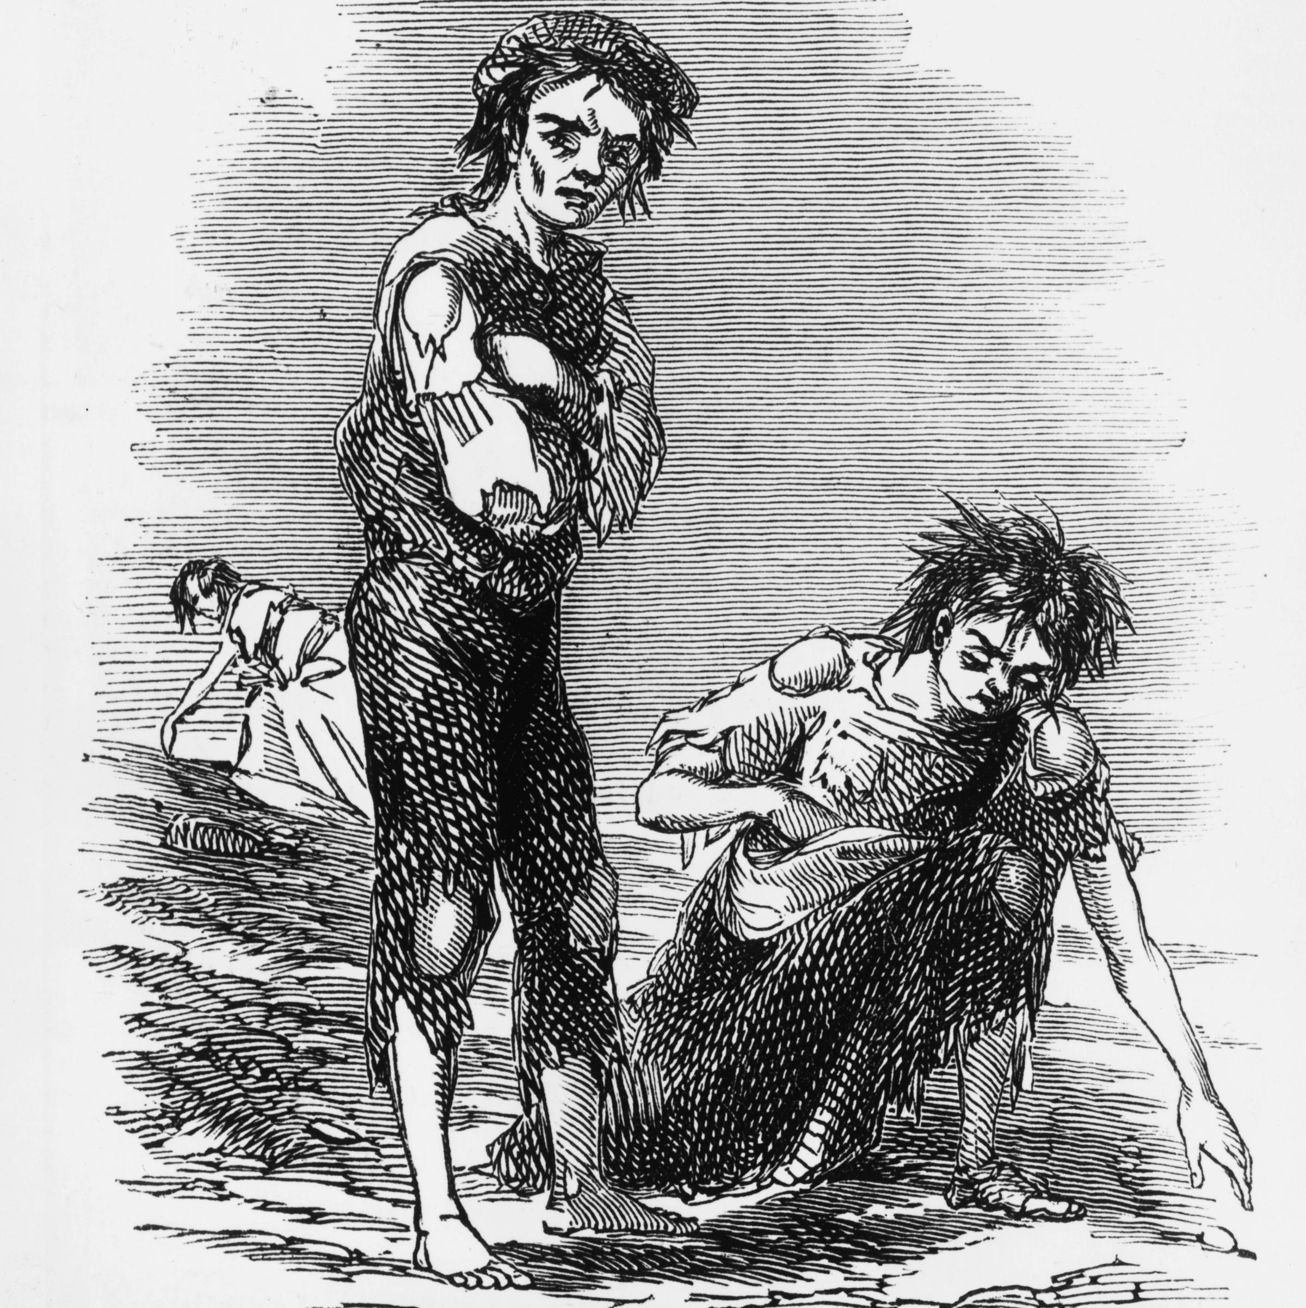
Background 1800s
Ireland is part of the British Empire
Unsuccessful Uprisings
Penal Laws:
Discriminated against Catholic & Presbyterians
Daniel O’ Connell campaigned for equal rights for Catholics
Inspired by the American and French Revolutions
The British Empire covers around 25% of the land area of the world. (Red in the map above)
1798 Rebellion (United Irishmen),
1848 (Young Irelanders) & 1867 (Fenians/IRB)
1801 Act of Union
The Great Famine 1845-1851
Ireland becomes part of the United Kingdom. Ireland is ruled from London. (Irish MPs go to London).
1 million die & 1 million emigrate: Population halved
Evictions
Coffin-Ships
Anti-British feelings

Slide 3
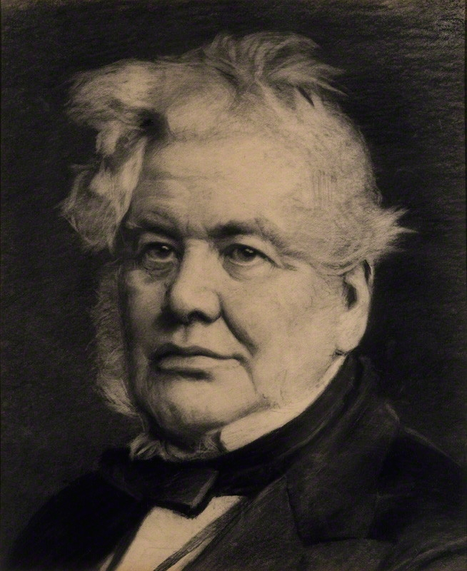
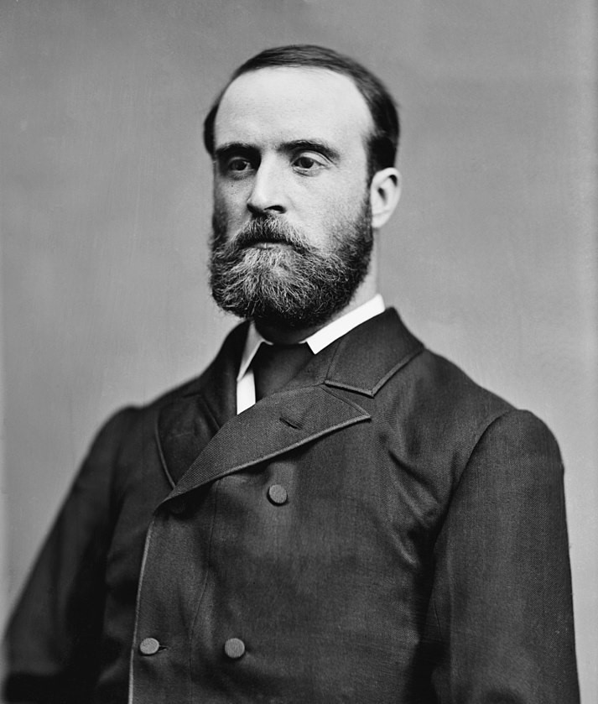
Nationalists - Home Rule
Home Rule:
Ireland ruled from Dublin, rather than from London. Ireland would still be part of the U.K.
Home Rule:
Verypopular in most of the country except in Ulster (where there were more Unionists)
Isaac Butt
Charles Stewart Parnell
From Stranorlar
Originally a Unionist – until he saw the effects of the famine
Founded the Home Rule Party (the Irish Parliamentary Party)
Protestant Landowner
Leader of the Home Rule Party after Isaac Butt died
The Home Rule Party became very powerful.
Land League & Landwar- campaign against landlords
After 3 attempts Home Rule Bill passed in London in 1914
Home Rule postponed because of World War One
Notes:
Home Rule Bills 1,2,3
Home Rule passed but postponed until the end of WW1
Sinn Fein – Arthur Griffith – own parliament in Dublin

Slide 4
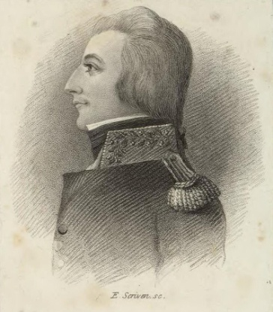
Growth of Unionism
Before1800 many leading Nationalists were Protestant – this changed
Unionists: Want to remain part of the United Kingdom
Wolfe Tone
Religion
Economy & Empire
Land
Violence
Nationalism had become tied to the Catholic Church. Protestants worried they would be discriminated against if Ireland was ruled from Dublin.
North-East Ulster was one of the only parts of Ireland with big industries (linen & shipbuilding).
The empire gave them access to big markets
Unionists believed they would be better off as part of the U.K.
Most big landowners were protestants. They feared a Dublin government would confiscate their lands.
Violence between Catholics and Protestants.
Most Unionists lived in Ulster. Southern Unionists were mostly wealthy landlords

Slide 5
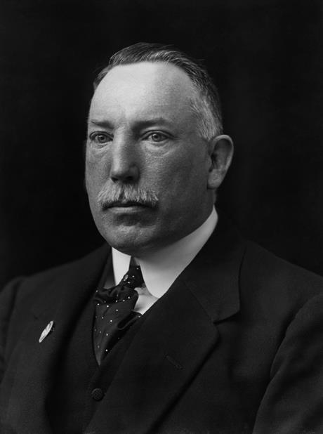
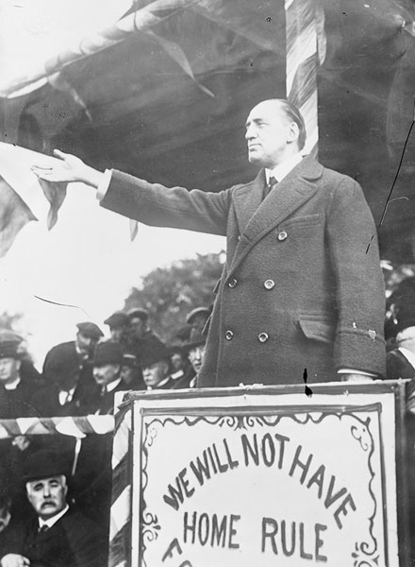
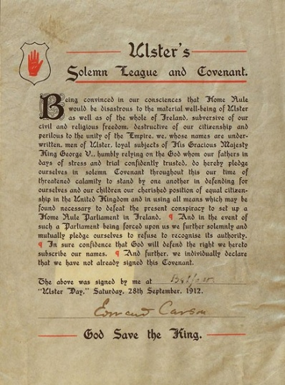
Unionist Resistance to Home Rule
James Craig
Edward Carson
Ulster Day 1912
Ulster Unionists promise to fight against Home Rule. Some sign in their own blood.
Carson and Craig wanted the whole of Ireland to stay in the U.K. They organise Unionist resistance to Home Rule.
Ulster Volunteers:
Private Army to fight against Home Rule.
Irish Volunteers: Private Army to fight for Home Rule.
Ireland was close to Civil War
Everything paused by World War One

Slide 6
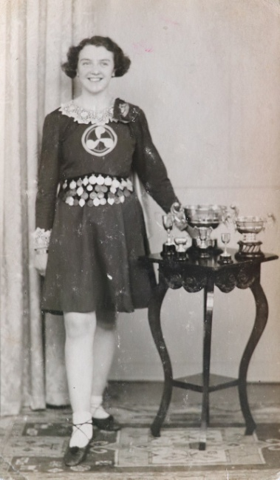
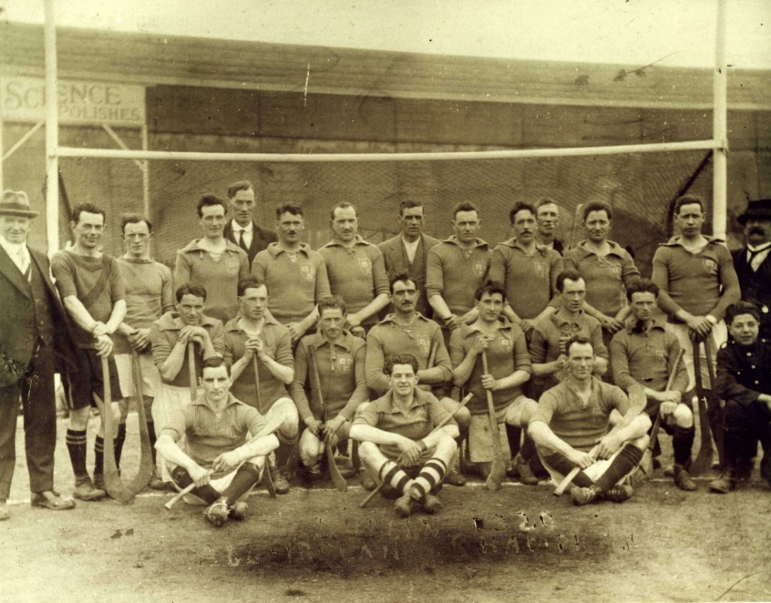
Gaelic Revival
Cultural Nationalism: – Using old Gaelic Culture to create an Irish identity
Gaelic League
Gaelic Athletic Association (G.A.A.)
Literary Revival
Promoted:
Irish Language
Irish traditional dances.
Many leading writers were southern protestants
Abbey Theatre
Irish Plays performed by Irish actors
Members banned from playing ‘British’ games
Political party set up by Arthur Griffith. Sinn Féin wanted Ireland to be independent from Britain but remain in the British Empire with the King as the head of State. Ireland would ignore the parliament in London and set up a government in Dublin.
Sinn Féin

Slide 7
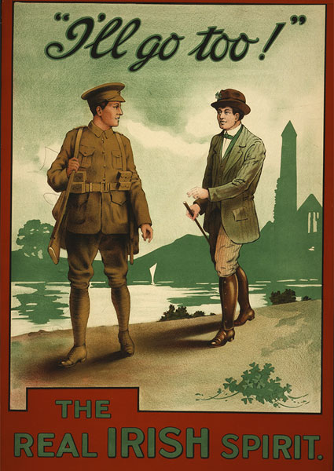
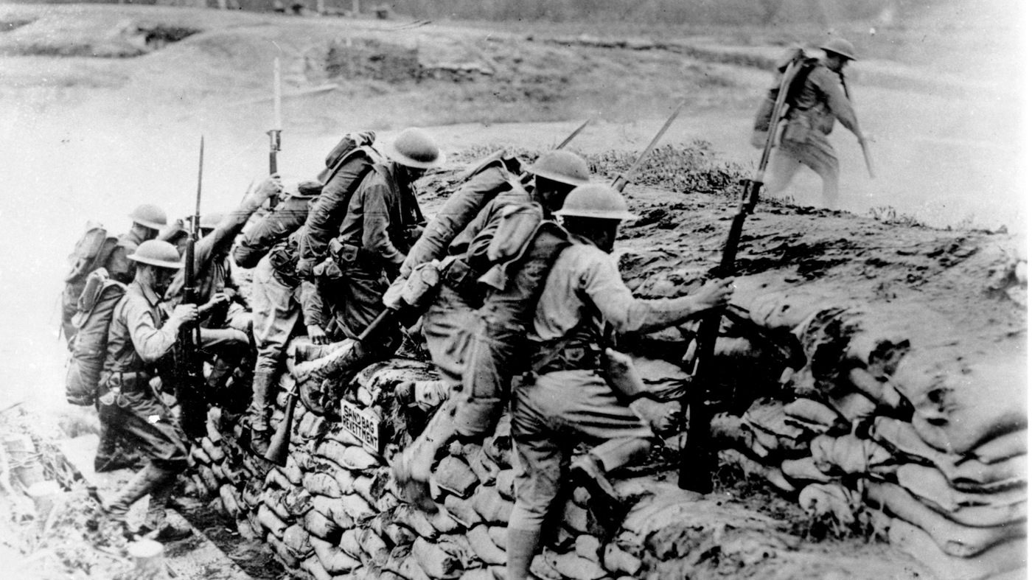
World War One
Trenches
Poison Gas
10 million soldiers died
Ulster Volunteer Force
Joined up to fight for Britain in World War One
Irish Volunteers
National Volunteer Force
Stayed in Ireland and secretly planned a rebellion (the Easter Rising)
Joined up to fight for Britain in World War One
“England’s difficulty is Ireland’s opportunity”
Threat of conscription in Ireland causes anti-British sentiment

Slide 8
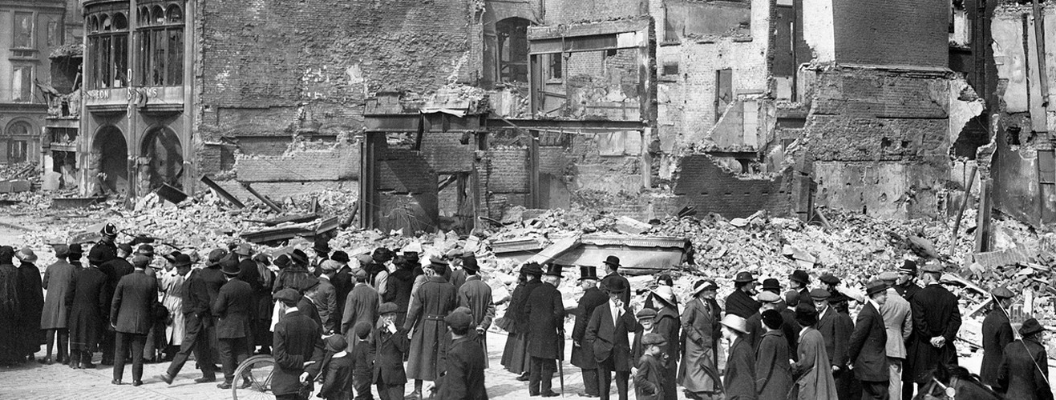
1916 Easter Rising
Problems for the rebels:
Shortage of weapons
Important buildings were not captured
Less rebels than expected
Rising happened in Dublin only
Rebel Groups involved:
I.R.B
Irish Volunteers
Irish Citizen Army
Cumann na mBán
2000 rebels occupied the G.P.O. and other important Dublin buildings.
They proclaimed the Irish Republic and raised the Irish flag for the first time.
British reinforcements arrived. British forces shell the city. The rebels surrender after 6 days.
At first public opinion was against the Rising: Large areas of Dublin were destroyed and civilians had been killed and wounded.

Slide 9
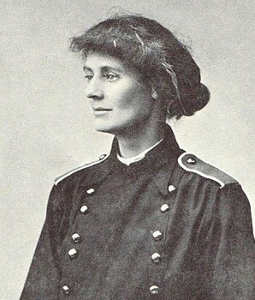
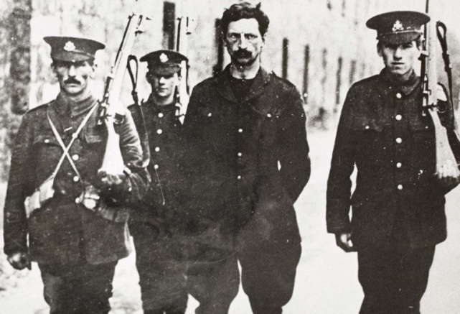
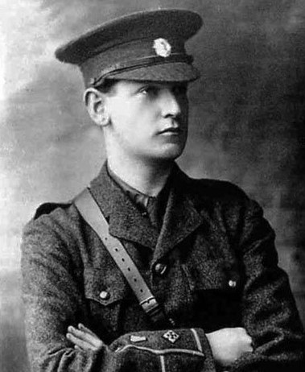
Easter Rising Aftermath
Executions
Public Support grows for the rising
British Reaction
Internment
Mass Arrests
The Easter Rising was (wrongly) called the Sinn Féin Rising
Countess Markievcz
Eamon De Valera
Michael Collins
Escaped execution because she was a woman
The only leader from the Easter Rising who was not executed. De Valera was not executed because he was an American citizen.
Sent to a prison camp where he became an important rebel leader

Slide 10
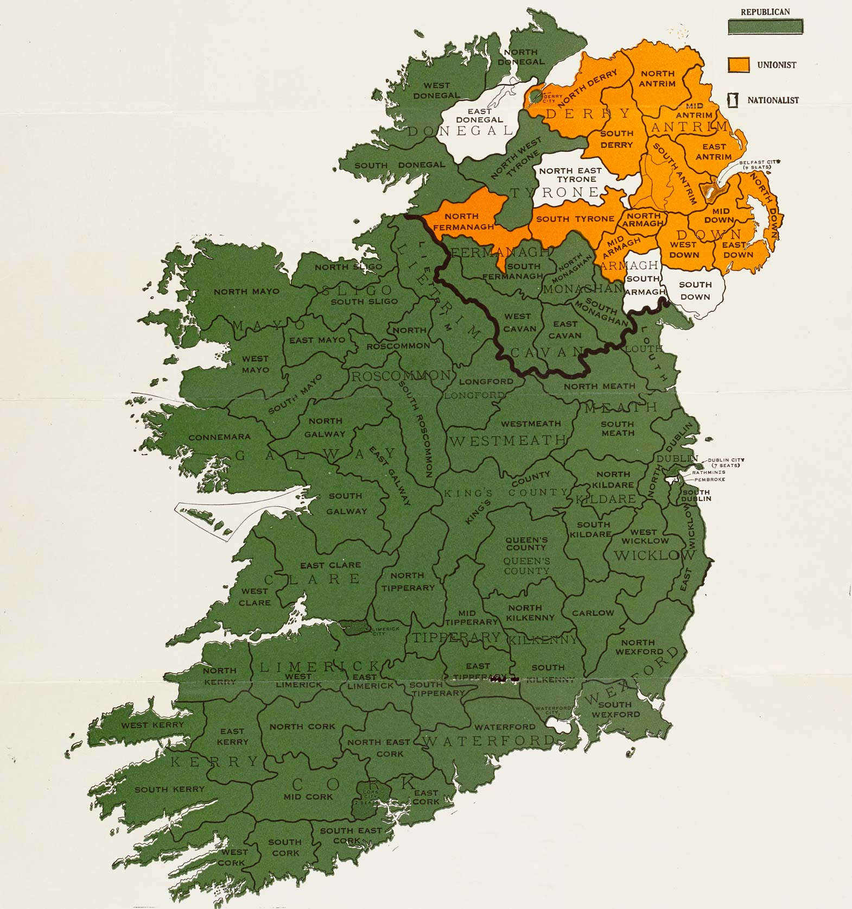
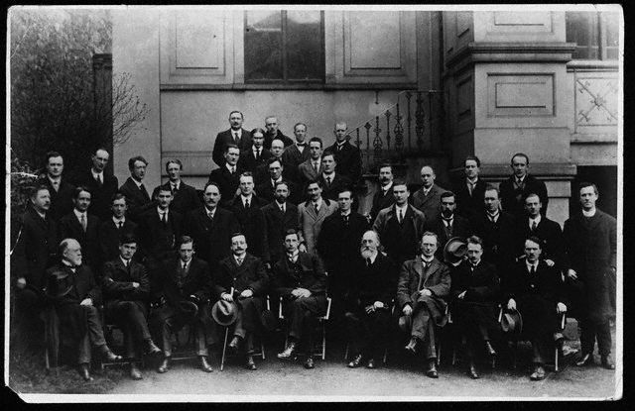
1918 General election, first Dáil
Refuse to take their seats in the parliament in London
November:
World War One ends
December :
General Election
Sinn Féin win most of the votes.
Women can vote for the first time. Markievcz would have been the first woman elected to the Parliament in Westminster.
Election Results
Green: Mostly nationalists elected
(Sinn Féin & Home Rule)
Orange: Mostly Unionists elected
Ulster is divided
Dáil Eireann 21 Jan 1919
Irish Independence announced
Many of the TDs still in jail after the Easter Rising. When the Dáil is banned in September the TDs go on the run.

Slide 11
The War of Independence

Slide 12
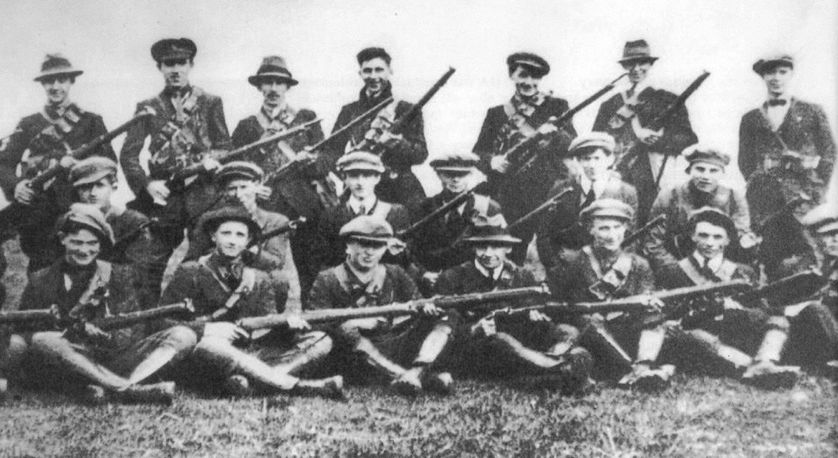
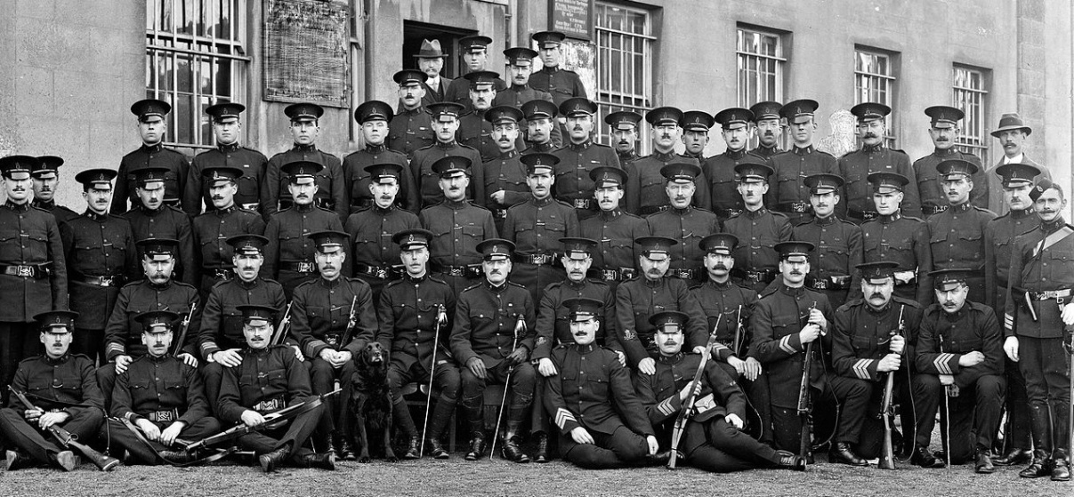
The War of Independence begins
War of Independence: First Shots
On the same day as the first Dáil met Irish volunteers ambushed R.I.C. policemen in Soloheadbeg. Two R.I.C. men were killed.
R.I.C. (Royal Irish Constabulary)
The police force in Ireland. It had both Catholic and Protestant members. The I.R.A. targeted them because they were symbols of British rule in Ireland.
During the War of Independence the Irish Volunteers become the Irish Republican Army: the army of the future Irish State.

Slide 13
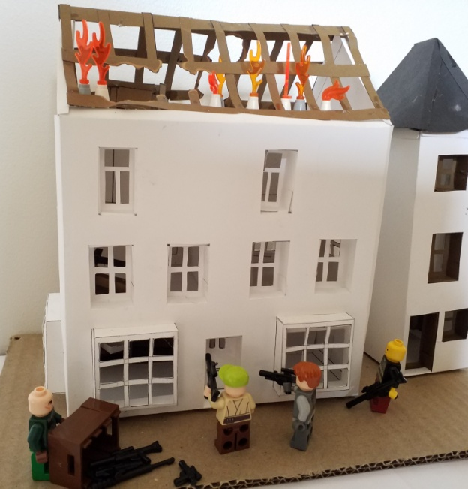
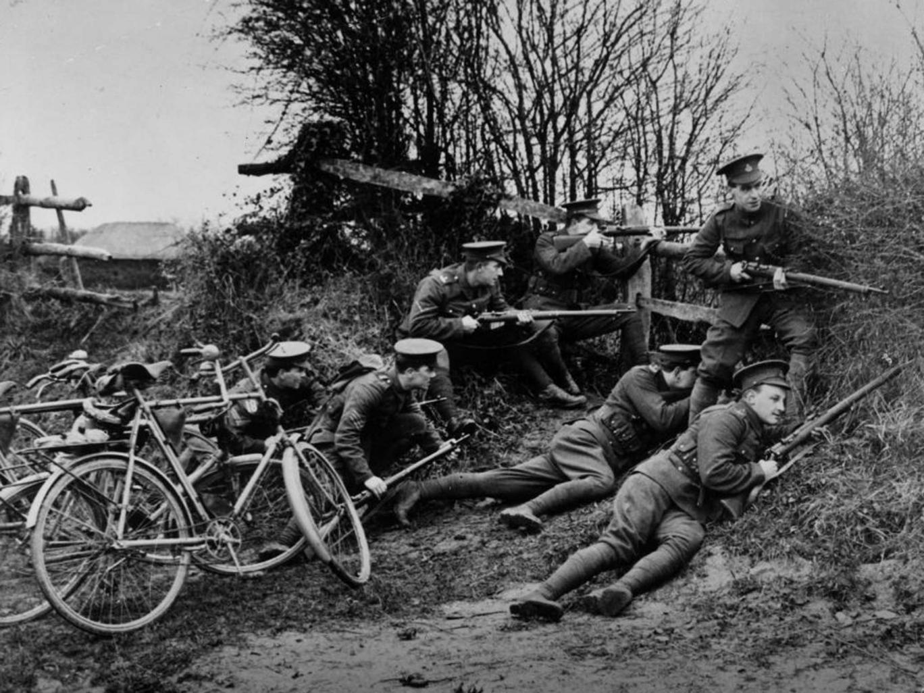
War of Independence: I.R.A. Campaign
1919-1921
Michael Collins: responsible for these tactics.
Guerilla Warfare
Volunteers told to treat British forces as an invading army
R.I.C. barracks were raided for their guns and ammunition
Ambushes (surprise attacks)by small groups of Irish Volunteers (called flying columns)
Eamon De Valera goes to the USA to get money and support from Irish Americans.
Sinn Féin and the Dáil: Non-violent resistance to British forces and set up to rule the country.

Slide 14
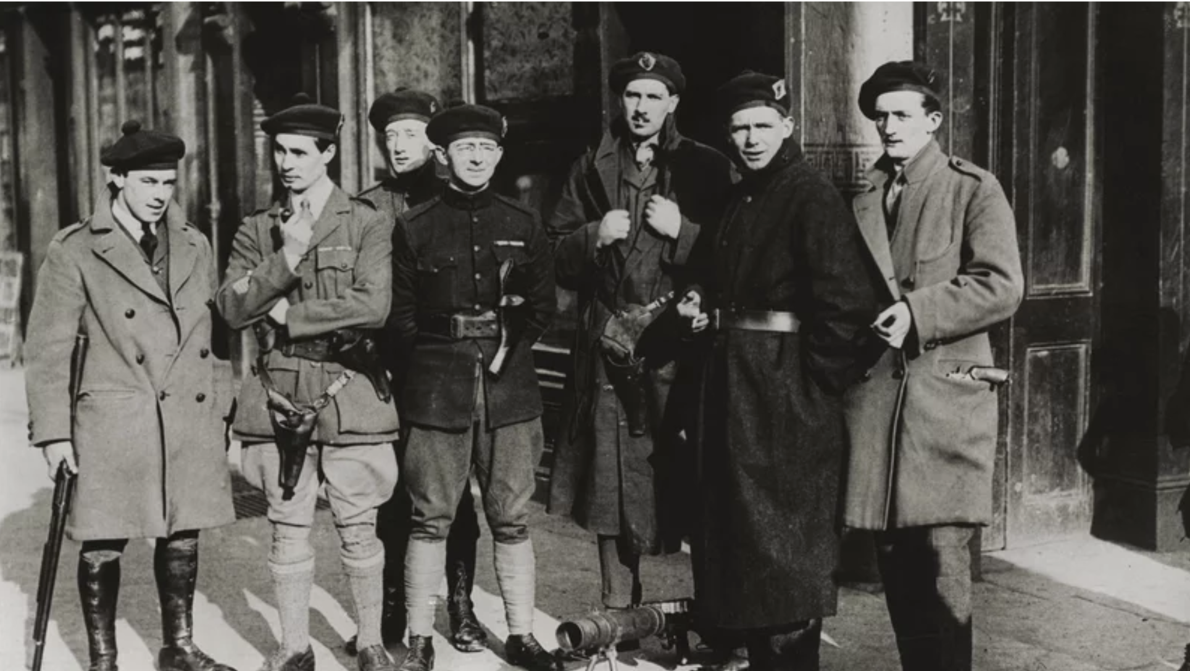
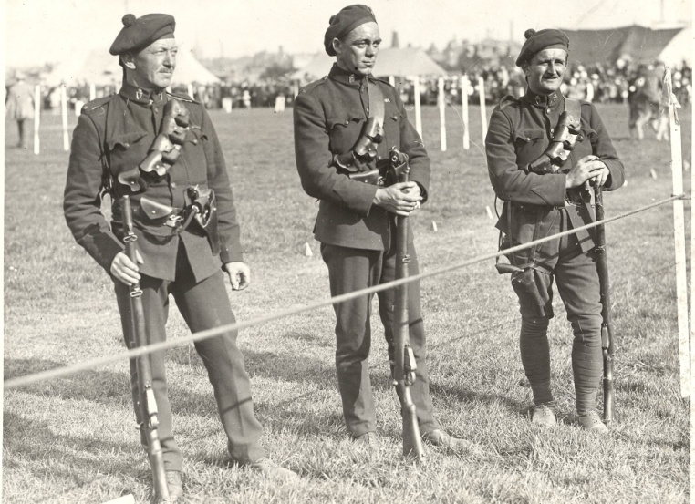
War of Independence: British Response
R.I.C. policemen had resigned or been killed during the I.R.A campaign.
The British government brought in new groups as reinforcements.
Reprisals: Attacks on the Civilians in response to I.R.A. attacks on British Forces
Black & Tans: British ex-servicemen. (WW1 veterans) Got their name from the colour of their uniforms.
Auxiliaries: Former officers from the British Army
Both Groups earned a reputation for Brutality
Hunger Strikes
Jailed without trials
International Criticism

Slide 15
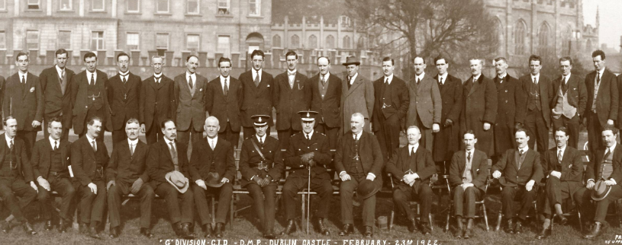
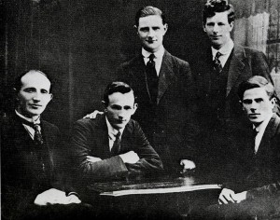
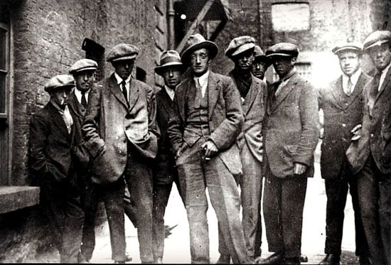
Intelligence & Espionage (Spying)
G-Men
The Squad/ The twelve apostles
Double Agents
Plain-clothed Dublin Metropolitan police. Intelligence against the I.R.A.. Sometimes carried out assassinations.
I.R.A. counter intelligence. Targeted and assassinated G-men
Cairo Gang
The Squad had left gaps in the British intelligence
British intelligence reinforcements

Slide 16
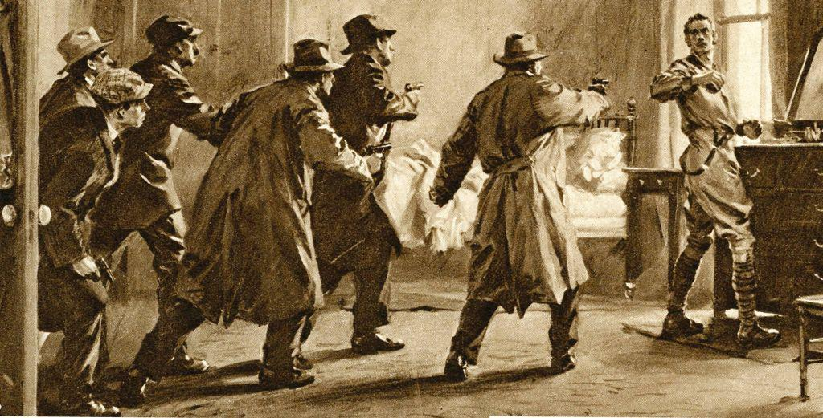
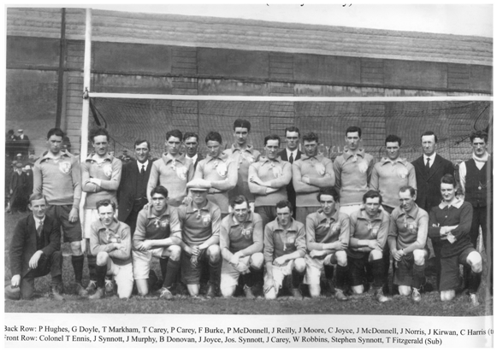
Bloody Sunday 21st November 1920
De Valera returns
The Squad kill assassinate 12 members of the Cairo gang. Two civilians are also killed.
In a revenge attack Black and Tans open fire on a G.A.A. match and kill 14 civilians. Two I.R.A. prisoners are also killed by Auxiliaries.

Slide 17
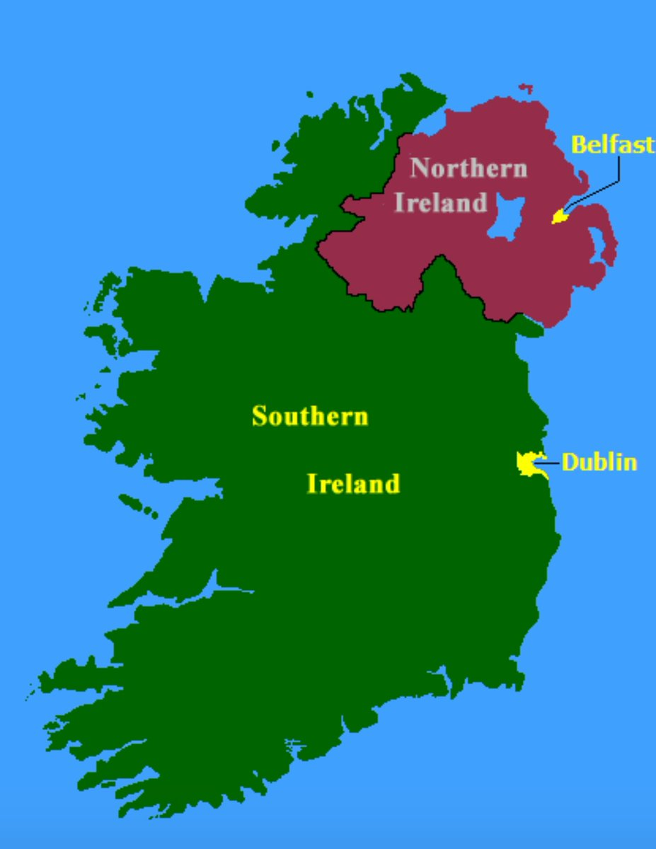
Government of Ireland Act 1920
Two Home Rule Parliaments in Ireland
Partition
Ireland was divided into two parts, separated by a border.
Parliament in Dublin
Controls the ‘south’ of Ireland
Parliament in Belfast
Controls six counties of Ulster: Area with a Protestant majority that would become Northern Ireland
Ireland was still part of the U.K.. Nationalists now wanted complete independence, not just Home Rule.
Sinn Féin and the I.R.A. ignore the Act.
Too little, too late
Eamon de Valera returns from America.

Slide 18
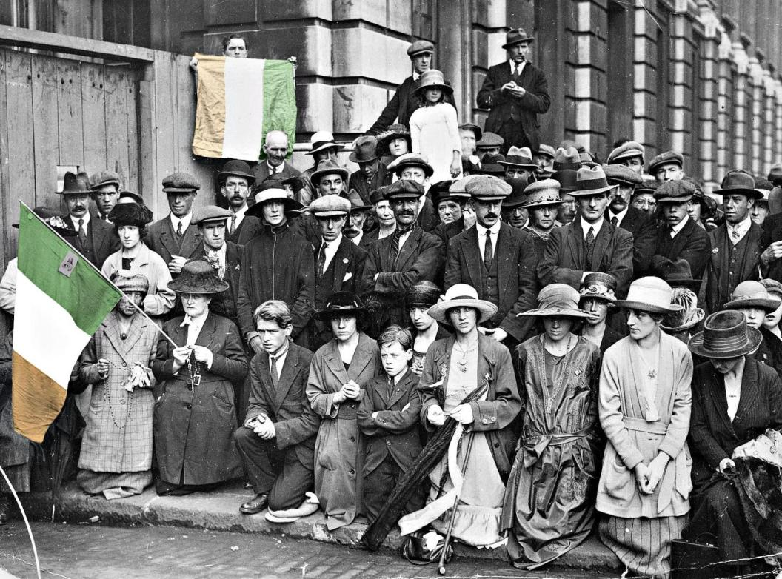
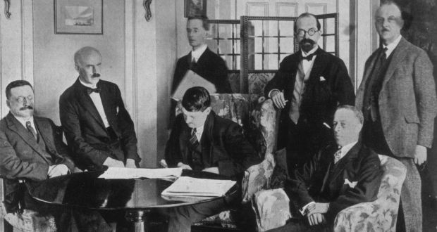
Truce & Treaty
Ceasefire & Truce 1921
2000 dead
I.R.A. running out of weapons and ammunition; cannot keep fighting.
British government criticised internationally for actions of Black and Tans.
Peace Conference
De Valera did not attend the negotiations. He sent a delegation, led by Arthur Griffith and Michael Collins.
The delegation was not supposed to sign a Treaty without Dáil agreement.
Under threat of war the delegation was pressured into signing without Dáil agreement.

Slide 19
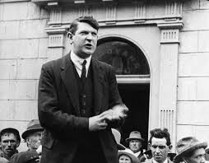
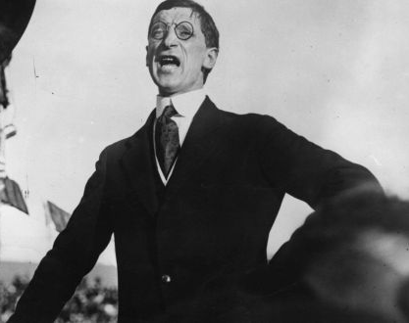
Treaty splits the country
The Dáil was divided: 64 to 57 in favour of the treaty
Pro-Treaty
Anti-Treaty
Best deal possible
I.R.A. couldn’t fight a war with the UK.
Partition
Free State still in the British Empire
A step towards independence.
Oath to the British King
Anti-Treaty side walk out of the Dáil

Slide 20
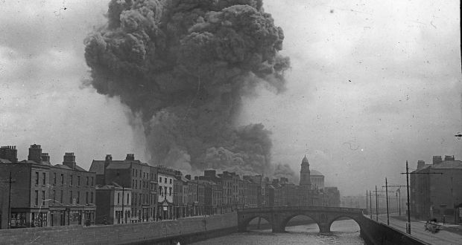
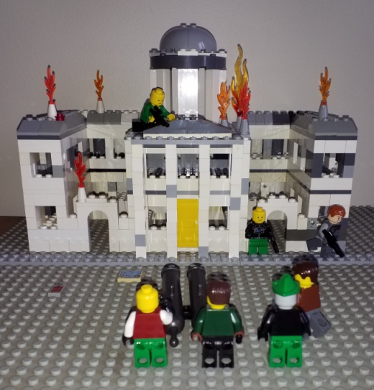
The Irish Civil War
Four Courts 1922: Start of the Civil War
Ireland was divided
Both sides try to control areas of the country
Atrocities on both sides
Anti-Treaty occupied the Four Courts. Under pressure from Britain the Pro-Treaty side fire on the building. The national Archives are destroyed.
Attacks and Reprisals
Executions
Many Big Houses destroyed
Micheal Collins killed in an Ambush

Slide 21
End of the Civil War
Catholic Church turned against the fighting
No more Weapons
Population wanted peace
Ceasefire:
April 1923
2000 dead
New Irish Free State set up
Ireland’s two largest political parties were formed from the two sides of the Civil War.
Fianna Fáil
Cumann na Gaedhal
(now Fianna Gaedhal)
Unarmed Gardaí set up
Civil War prisoners not released until 1924
De Valera dismantles the Free State and the Anglo-Irish Treaty from within;
In 1949 Ireland becomes a republic.

Slide 22
Glossary
Ambushes: surprise attacks
Atrocities: a very cruel or ruthless act
Ceasefire: An agreement to stop fighting
Civil war: war between people of the same country
Dáil Eireann: Assembly of Ireland. The Irish name for the parliament set up in 1919.
Discrimination: Treating a person/group unfairly
Executed: Put to death as punishment for a crime.
Flying Columns: Groups of rebels who trained together before attacking other groups in the War of Independence.
Guerilla warfare: a type of warfare in which small groups of soldiers carry out surprise attacks on their enemies.
Home Rule: Having a parliament ‘at home’ in Dublin to rule Irish affairs.
Nationalists: People who wanted Ireland to rule itself from a parliament in Dublin, rather than being controlled by Britain.
Negotiations: Discussions about an issue in an effort to find a solution.
Oath of Loyalty: A promise to be loyal and support someone or something.
Partition: The division of Ireland into two states with a border between them.
Republic: A country belonging to the people, not a king or queen.
Tactics: Decisions about how to fight a war.
Truce: An agreement to stop fighting.
Unionists: People in Ireland who wanted to keep the Union with Britain.

